Slide 1
FriendTransfer: Cold-start Friend Recommendation with Cross-platform Transfer Learning of Social Knowledge
Ming Yan, Jitao Sang, Tao Mei, ChangSheng Xu
¹ Institute of Automation, Chinese Academy of Sciences
² Microsoft Research Asia, Beijing, P.R. China
Jun 30, 2013
Notes:
Good morning, everyone! I’m Ming Yan, from Chinese Academy of Sciences.
Today, I will talk about a novel cold-start friend recommendation application based on cross-platform collaboration.

Slide 2
Outline
Motivation
Data Analysis
Application
Conclusion
Notes:
First I will introduce the background and our motivation.
Then an in-depth data analysis on cross-platform user relation and behavior will be provided.
Based on the data analysis, we further design a cold-start friend recommendation application.
Finally comes the conclusion.

Slide 3
Outline
Motivation
Data Analysis
Application
Conclusion

Slide 4
burst of social media sites
5.6 social media accounts per user
Visit about 3 different social media sites per day
Aggregation tools/websites
about.me
FriendFeed
Google+
possibility to perform user-centric cross-platform data analysis
Notes:
Nowadays, social media is very popular. Various and massive social media sites spring up like mushrooms.
This in one way leads to that more and more users are engaged in multiple social media sites simultaneously. (read script on slides).
In another way, some aggregation tools have been developed to aggregate user accounts in different social media sites such as about.me, FriendFeed and Google+.
These both provide huge possibility to perform user-centric cross-platform data analysis.

Slide 5
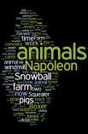
FriendTransfer
Motivation: how can we exploit rich social information of users in an auxiliary platform to help another platform perform the cold-start friend recommendation task.
auxiliary
platform
group
image
join
upload
tag
tag cloud
tag
target
platform
？
？
tweet
post
post
tweet
Notes:
Now let’s think about a scenario like this:
Image you are an experienced user in flickr, where a friend network is carefully maintained and social activities are updated everyday (join interesting groups, upload images and tag the images).
When Twitter becomes popular, it will be difficult if you desire to try this new service, since you are totally new in this platform (you don’t know who and where your friends are) and the new platform knows nothing about your interests for intelligent recommendation.
Therefore, our motivation is how can we exploit rich social information of users in an auxiliary platform to help another platform perform the cold-start friend recommendation task. (with user accounts association)

Slide 6
Related Work
Friend suggestion based on a single platform
Topology / Structure (David Liben-Nowell et al. CIKM’03)
Homophily (Jinfeng Zhuang et al. MM’11)
Cross-platform Analysis
Cross-platform collaboration (F. Abel et al. UMUAI’11, Suman D. Roy et al. MM’12)
Multi-platform difference analysis (Kristina Lerman et al. ICWSM’10)
Friend suggestion will fail for completely cold-start scenario.
Not on user level for most cross-platform analysis.
Notes:
Now let’s first review some related work, mainly two parts:
The first part is related with the friend suggestion methods, where topology or structure and homophily are always utilized.
The second part is cross-platform analysis, where cross-platform collaboration and multi-platform difference analysis have been widely studied.
For the previous work, friend suggestion will fail for completely cold-start scenario, social topology and user-centric are not well explored for most cross-platform analysis.
Topology: Based on the number of common friends
Homophily: suggest users whose profiles, interests, or updates have substantial overlap with the receiver of the recommendation

Slide 7
Our Work
Two Parts
Cross-platform Data Analysis
Cold-start Friend Recommendation
Flowchart
Relation&
Behavior
Observation
Results
Data Collection
Data
Analysis
Application
Notes:
Our work has analyzed what social relation and behavior can better transfer user preferences between different platforms (that is what information can better transfer from one platform to another), and how to combine them for improved applications, therefore we have mainly two parts of work:
One: data analysis work and the other one: friend recommendation application with cross-platform transfer.
This is the overall flowchart of our main work (data collection, data analysis and friend recommendation application based on the data analysis) and we will describe every part one by one in detail later.

Slide 8
Outline
Motivation
Data Analysis
Application
Conclusion

Slide 9
Data Collection
Interested groups
Image set
Tag cloud
person
bird
tree
sky
beach
Contact list
40K users
1,457 users
Flickr
Friend list
crawl
filter
Tweets
Twitter
Jack: I’m a fan both in Flickr and Twitter
All User Accounts | 40K
Users With Both Accounts | 3,003
Both Accounts + Not isolated | 1,457
Follower list
Notes:
To obtain a collection of users who have both accounts in Flickr and Twitter, we started from google+ website and collected about 40k users in total.
Then we kept only those who have both flickr and twitter accounts and filtered the isolated users, which results in the final 1,457 user dataset.
Meanwhile, the users’ rich social context information are also downloaded from their Flickr and Twitter accounts respectively (such as image set, interested groups and contact list).
Most of the subsequent data analysis work is done in this dataset.

Slide 10
Data Analysis
Three Questions
1
Relation can transfer?
2
What type relation for easier transfer?
3
Behavior and relation can collaborate?
Notes:
Now let’s focus on our data analysis work.
The following three questions can be the main line for our data analysis work
1. Do the user relations can transfer across different platforms?
2. What type of social relation is easier to transfer across different platforms?
3. Do the social behavior and relation can collaborate in some way?

Slide 11
Data Analysis
Three Questions
1
Relation can transfer?
Flickr
Twitter
Notes:
Now let’s answer the questions one by one.
For the first question,
We analyze to what extent can relations on one platform transfer to another platform.

Slide 12
Social relation Analysis
A global analysis
High transfer ratio and more closely connected in Flickr
Social Platform | Bidirectional follow ratio (in friends) | Cross follow ratio (in friends) | Avg(Contact Num)
Flickr | 0.5843 | 0.55 | 111.93
Twitter | 0.4503 | 0.315 | 1273.84
Table. Global social relation situation between Flickr and Twitter
4 types of relations:
(1) No relation (2)Unidirectional relation
(3) Bidirectional relation (4) Cross follow relation
Notes:
We made a global analysis on the user relation situation in Flickr and Twitter respectively.
Because Flickr and Twitter are both directional social network, we define 4 types of social relations between users: No relation (we don’t follow each other), Unidirectional relation (I follow you, but you don’t follow back on me), bidirectional relation (I follow you, and you also follow back on me), and also a cross-platform user relation which we call cross follow relation (it means I follow you both in Flickr and in Twitter)
The table shows the results, we can see that Twitter has a much larger social circle than Flickr while Flickr is more closely connected and has a higher transfer ratio.

Slide 13
Data Analysis
Three Questions
2
What type relation for easier transfer?
Flickr
Twitter
Notes:
As we have different types of relations both in Flickr and Twitter,
We further analyze what type of relation is easier to transfer across different social platforms (bidirectional or unidirectional?).

Slide 14
Social relation Analysis
Bidirectional relation is more reliable
Table. Comparison of relation type transfer situation
Notes:
This table shows the comparison of relation type transfer situation. We count how many bidirectional friend pairs and unidirectional friend pairs in Flickr become bidirectional, unidirectional or no relation in Twitter respectively.
The result shows the bidirectional relation has a much higher transfer ratio, so it’s more reliable for this type of relation to transfer.

Slide 15
Data Analysis
Three Questions
3
Behavior and relation can collaborate?
group
join
tag
Flickr
join
tag
Twitter
Notes:
Other than multiple social relations, users also have rich social behaviors.
So we further try to investigate whether social behavior and social relation can collaborate in some way.

Slide 16
Social Behavior Analysis
We model the user similarity in three ways:
Common Contact Number (CCN)
Common Interested Group Number (CGN)
Tag-based Similarity (TBS)
Social behavior and relation have consistency
relation or not | Avg.CCN | Avg.CGN | Avg.TBS
With relation | 20.2777 | 4.8649 | 0.0550
Without relation | 2.4259 | 1.9430 | 0.0211
Table. Comparison of the social behaviors between the user pairs with and without relations
Notes:
For the social behavior analysis, we model the user similarity in the following three ways using their rich behaviors:
This table shows the comparison of the social behaviors between the user pairs with and without relations.
We can see that friends have a bigger common contact number, common interested group number and tag-based similarity than unknown user pairs which indicates that social behavior and relation have some sort of consistency.

Slide 17
Social Behavior Analysis
Common contact and tag-based profile can promote cross-follow relations
relation type | Avg.CCN | Avg.CGN | Avg.TBS
Only follow in Flickr | 15.7250 | 5.3340 | 0.0403
Cross follow both in Flickr and Twitter | 23.0743 | 4.5768 | 0.0913
Table. Comparison of the social behaviors between the user pairs with and without cross-follow relations
Notes:
To further facilitate our cross-platform transfer analysis, we also make a comparison of the social behaviors between the user pairs with and without cross-follow relations.
From the table we can see that cross follow user pairs have bigger common contact number and tag-based similarity which indicates these two kinds of behaviors can further promote cross-follow relations to some extent.

Slide 18
Data Analysis Results
1
Flickr more closely connected than Twitter
2
Bidirectional relation is more reliable
3
Social behavior and relation have some sort of consistency
4
Common contact and tag profile can promote cross-follow
Notes:
Finally we got the following four observations from data analysis results.
Based on these observations, we further design a cold-start friend recommendation application with cross-platform boosting.

Slide 19
Outline
Motivation
Data Analysis
Application
Conclusion
Notes:
Next, I will introduce our application.

Slide 20
Cold-start friend recommendation
Formulation
We formulate our application as a random walk with restart problem on the user graph.
$$r_{k}(j)=α\sum_{i}{\left.r_{k−1}(i)p_{ij}+(1−α\right)}v_{j}$$
Relevance score of node j at iteration k
Initial restart score for each node
Transition probability from node i to node j
Iterate until a final stable state:
$$r_{π}=(1−α){\left(I−αP\right)}^{−1}v$$
Notes:
In our application, we deal with the top-k friend recommendation problem by leveraging user’s rich social information in another platform.
And we formulate the application as a random walk with restart problem on the user graph where users are nodes and edges between them are weighted by their similarity on social behavior.
We iterate the random walk process until a final stable state is arrived and the final recommendation list is obtained by sorting the stable relevance score r(j)

Slide 21
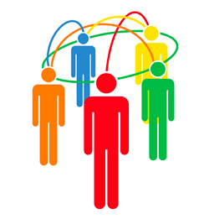
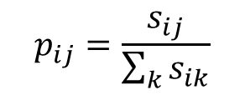
Cold-start friend recommendation
Formulation details
$$v_{j}$$
Social relation transfer: initial relevance score
$$\left\{\begin{aligned}0, if u_{i} has no relation with u_{j} \\ 1, if u_{i} has unidirectional relation with u_{j} \\ 2,if u_{i} has bidirectional relation with u_{j }\end{aligned}\right.$$
$$v_{j}=$$
$$p_{ij}$$
Social behavior transfer: transition probability
$$p_{ij}=\frac{s_{ij}}{\sum_{k}{s_{ik}}}$$
Notes:
Based on the data analysis, we formulate the parameter (mainly initial relevance score vj and transition probability pij) in our random walk model as below:
For the social relation transfer, as the social relations have high probability to transfer (especially the bidirectional relation), we formulate the initial relevance score vj with the social relation like this.
For the social behavior transfer, as the common contact behavior and tag-based profile can promote cross-follow relationship, we formulate the transition probability pij mainly with these behaviors.
Finally we combine the reliable social relation with the convinced social behavior to make better recommendation.
(Note that these formulations are all computed by leveraging the information in another social platform since it’s cold-start in the original platform.)

Slide 22
Experiment
Experimental Settings
328 users with accounts both in Flickr and Twitter
315k images with tags in Flickr
8.01 friends in Flickr and 13.34 friends in Twitter
Evaluation Metrics
Top-k average precision, recall and F-score
Baseline methods
Friend(Frd), Common Contact(CC), Tag, Group(Grp)
Frd + CC, Frd + Tag, Frd + Grp
Notes:
These are our final experiment settings.
And we utilize the top-k average precision, recall and F-score as our evaluation metrics.
For the baseline methods, we have two kinds of baselines:
The first kind uses only one kind of information to sort users, the other one directly combines two kinds of information to sort users (e.g. friend and also high common contact number then more likely higher relevance score)

Slide 23
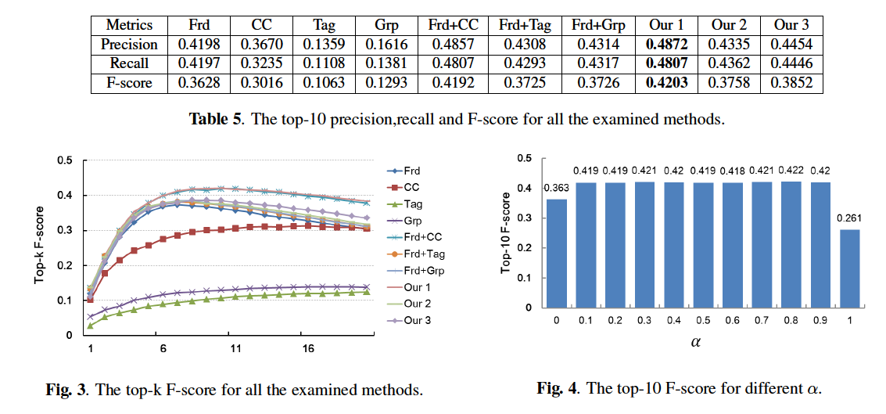
Experiment Results
Notes:
These are our final experiment results.
We can see that all the methods that combine social relation information with social behavior information (5-10th in Table 5) can achieve better results than the methods which only utilize one type of information (1-4th in Table 5) and our random walk based method which combines two kinds of information (Our1, Our2, Our3) outperforms the baseline method that directly combines them (5-7th in Table 5).
We also analyzed the results to different tradeoff parameter $α$ (the right figure), and the performance is not sensitive to the change of this parameter which validates the robustness of our algorithm.

Slide 24
Outline
Motivation
Data Analysis
Application
Conclusion
Notes:
Finally come to our conclusion.

Slide 25
Conclusion
Contributions
An in-depth data analysis on cross-platform user relation and behavior information
Cold-start friend recommendation by leveraging rich information in another social platform
A simple but robust random walk based fusion method for heterogeneous social information
Future work
Fusion of social information in different modalities
Cross-platform social pattern mining
Notes:
To summarize, we have these contributions:
We conduct an in-depth data analysis on cross-platform user level
We design a cold-start friend recommendation application with cross-platform boosting
We utilize a simple but robust random walk based fusion method to combine social relation with social behavior information.
Our future work includes the fusion of multiple social information in different modalities across different social platforms and we are also expecting to mine some general cross-platform social patterns in nature.

Slide 26
Thanks!
Q&A
Notes:
Thanks for your time and attention.

