Slide 1
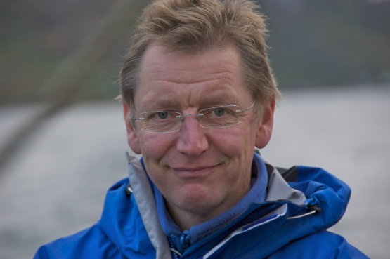
Name, affiliation, contact info, photo, some general interest info.
Name: Thomas Plagemann
Affiliation: University of Oslo
Contact info: plageman@ifi.uio.no
General interest:
Multimedia systems and applications
CPS computing

Slide 2
Current research focus
Currently we are working on two aspects
Cyber Physical Systems
Distributed complex event processing in mobile networks
Quality of Information & energy awareness
Using impulse radar for non intrusive sensing in AAL
Mobile multimedia applications
Migrate parts of multimedia applications dynamically to the best suited device in a community
- Simulation of mobile systems
- Network level redundancy elemination

Slide 3
Interest in the proposed theme of the workshop
We would like to discuss and explore CPS data sensing, processing, and tools for developing CPSs

Slide 4
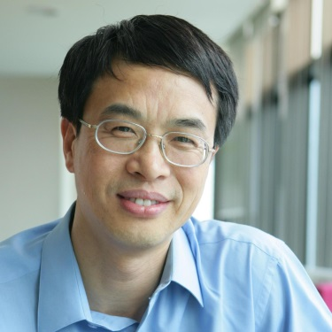
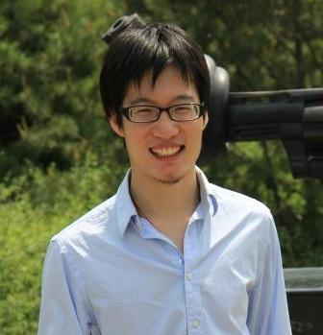
Name, affiliation, contact info, photo, some general interest info.
Name: Wenwu Zhu, Peng Cui
Affiliation: Tsinghua University
Contact info: wwzhu@tsinghua.edu.cn
cuip@tsinghua.edu.cn
General interest:
Social multimedia computing
CPS computing

Slide 5
Current research focus
Currently we are working on two aspects
Social-sensed multimedia computing
How to use social information, such as user behavior, user interests, user relations, user profile, to help with multimedia computing to reduce the intention gap
CPS data sensing and analytics
How to collect and analyze data

Slide 6
Interest in the proposed theme of the workshop
We would like to discuss and explore CPS data sensing, analytics, and decision

Slide 7
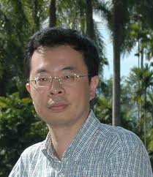
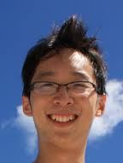
Name, affiliation, contact info, photo, some general interest info.
Name: Changsheng Xu, Jitao Sang
Affiliation: CASIA
Contact info: csxu@nlpr.ia.ac.cn
jtsang@nlpr.ia.ac.cn
General interest:
Multimedia content analysis/indexing/retrieval
Social multimedia computing

Slide 8
Current research focus
Currently we are working on three aspects
Computer Vision and Multimedia Content Analysis
User-centric Social Multimedia Computing
Multimedia Applications

Slide 9
Interest in the proposed theme of the workshop
Research
Cyber-Physical complex association mining and modeling
Cyber-Physical interaction and sensing
Application
Collaborative social community analysis
Collaborative social event analysis

Slide 10
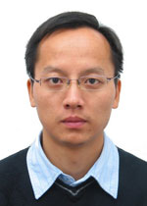
Fei Wu Full Professor, Ph.D. College of Computer Science Zhejiang University Email: wufei@cs.zju.edu.cn Website: http://www.dcd.zju.edu.cn/index.php/teacherdetail/index/id/0002353

Slide 11
Fei Wu is the vice-director of institute of artificial intelligence of Zhejiang University and the vice-director of Key Laboratory of Visual Perception (Zhejiang University) , Ministry of Education and Microsoft. He serves as the PC member of ACM Multimedia 2012, 2013. His research interests mainly include multimedia retrieval, sparse representation and machine learning. From October, 2009 to August 2010, Fei Wu was a visiting scholar at Prof. Bin Yu's group, University of California, Berkeley.

Slide 12
Nowadays, many real-world applications in CPS (Cyber space-Physical space-Society) involve multimodal data. Cross-media retrieval is imperative to many applications of practical interest, such as finding relevant textual documents of a tourist spot that best match a given image of the spot or finding a set of images that visually best illustrate a given text description. However, the heterogeneity-gap between multi-modal data has been widely understood as a fundamental barrier to successful cross-media retrieval. In this workshop, I will discuss some techniques about cross-media retrieval, hashing and ranking.

Slide 13
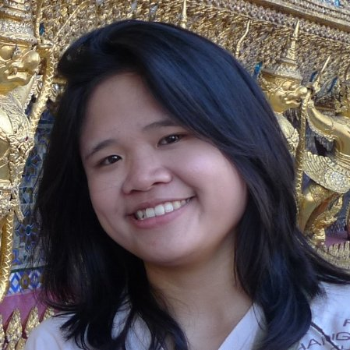
UCIRVINE
Donald Bren School of Information and Computer Sciences
Siripen Pongpaichet
PhD Candidate,
Academic Advisor Prof. Ramesh Jain
Contact:
spongpai@uci.edu
Interest:
complex event stream processing, multimedia information system, large scale data management,
having fun doing research ☺

Slide 14
Current Research
Toward Social Life Network from multimedia data stream using event stream processing platform called “EventShop”
Building Health Persona from personal data stream using “Personal EventShop”
Proposed Theme
Macro situation detection and micro (personal) situation detection aspect in CPS computing including data analytics and visualization
Healthcare related application

Slide 15
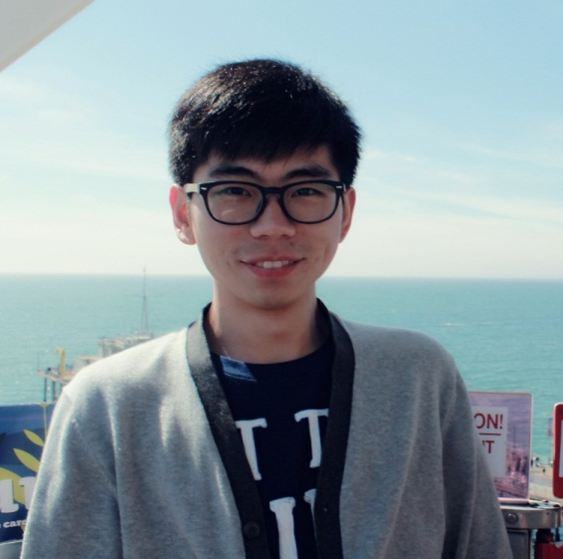
Self Introduction
Weizhe Ni (倪炜哲)
Education
Master, UCI, Computer Science
Bachelor, Tsinghua, Engineering Physics
Contacts
Email: weizhen@uci.edu
Cell: +1(949)-394-2953

Slide 16
Research Focus
Front-end Development
Multimedia Applications
Visual Computing
Data Mining

Slide 17
Interested Aspects
Novel Cross-disciplinary Social Network Applications
Event Aggregator
Image Sharing Applications
Healthcare/ Sports Sharing Multimedia Systems (NikePlus)

Slide 18
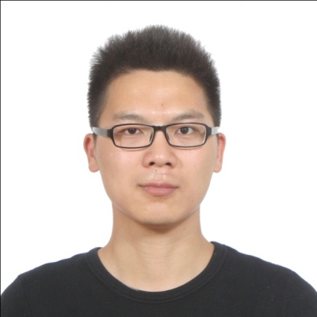
Name, affiliation, contact info, photo, some general interest info.
Name: Eric Huo
Affiliation: UCI
Contact info: huod@uci.edu
General interest:
Social Life Networks
Social multimedia computing

Slide 19
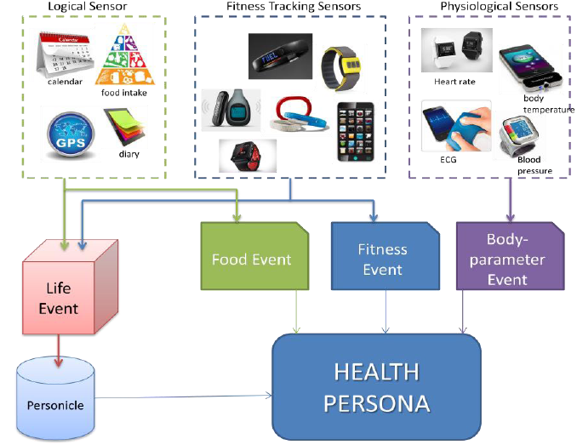
Current research focus
Currently I am working on building the Health Persona framework for Social Life Networks

Slide 20
Interest in the proposed theme of the workshop
I would like to discuss the CPS data sensing and cross-disciplinary application, e. g. healthcare application.

